Slide 1

Oops, I open up the system permission to everyone by accident
Yuanyuan Zhou (UCSD)
Joined work with my graduate students and my collaborators
Notes:
Thanks for the very nice introduction. Hi, everybody, I’m Tianyin, It’s a great pleasure to be there. Today, I’d like to talk to you about defending cloud and datacenter systems against configuration errors.

Slide 2
事先道歉声明
本报告尽量用中文
除了计算机术语
偶尔需要大家帮忙
中文做报告不流利
声明：和母校北大的教育无关 ☺

Slide 3



Security is getting worse!

Slide 4

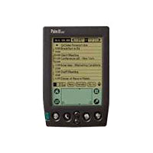


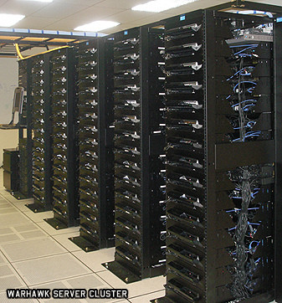
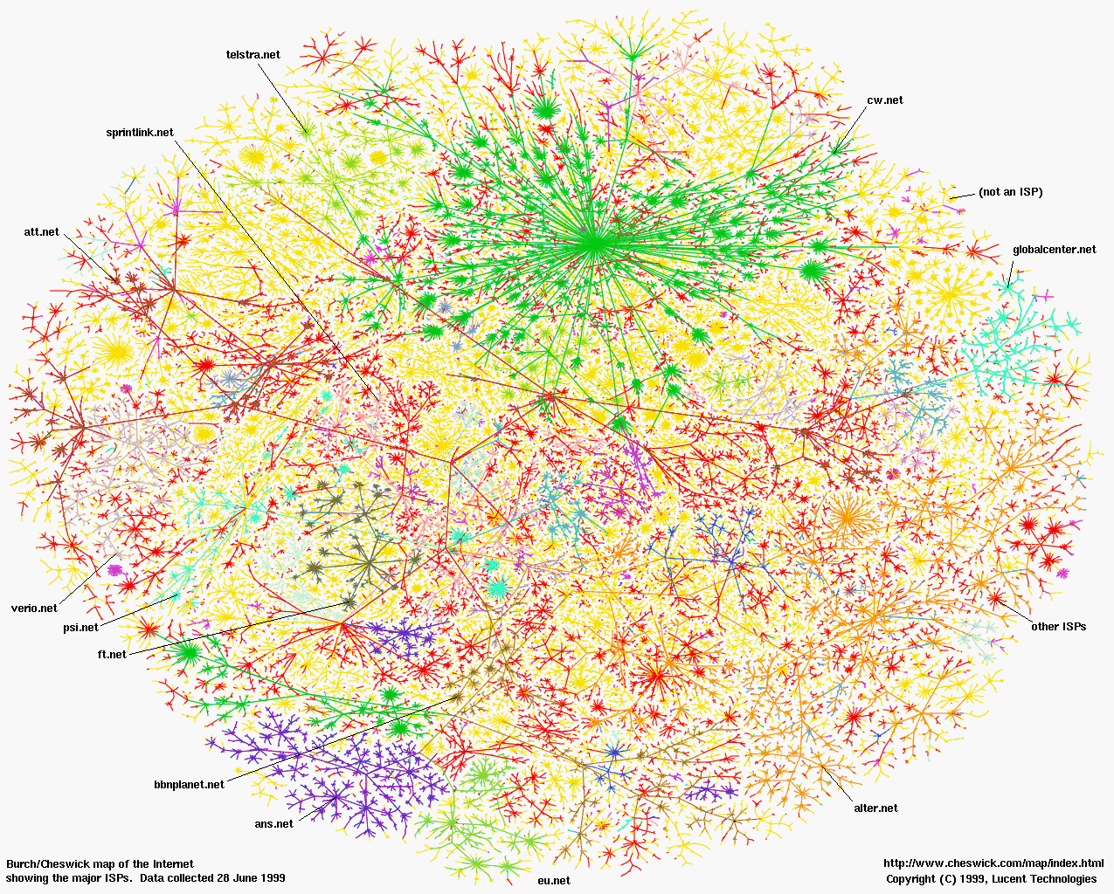



Security will become more important!
DeviceNets & SensorNets
E-Commerce
Banks/Finance
Healthcare
Online payment
Self-driving car

Slide 5
Access Control is a 50 years old problem
Principle of Least Privilege
Every program and every privileged user of the system should operate using the least amount of privilege necessary to complete the job.
— Jerome Saltzer, Communications of the ACM [1974]
A lot of research has been done
New security policy
Access permission enhancement (e.g. SELinux)

Slide 6
But the human factor is significantly Ignored!
What human factors?
System admins who set all those access permissions!!
Wikipedia definition 系统管理员
A system administrator, or sysadmin, is a person who is responsible for the upkeep, configuration, and reliable operation of computer systems; especially multi-user computers, such as servers. The system administrator seeks to ensure that the uptime, performance, resources, and security of the computers they manage meet the needs of the users。

Slide 7



Sysadmin access misconfigurations are serious.
Top-5 most critical web application security risks
The most common security vulnerabilities (found in 68% of analyzed apps)
40,000+ misconfigured MongoDB databases were openly available on the Internet
5
Notes:
I shall mention that security misconfigurations are serious problems in the real world.
They are reported among the most critical web application security risks,
and the most common security vulnerabilities by organizations such as OWSAP and HP Enterprise.
They are responsible for a number of real-world security disasters such as massive data breaches and server compromises.

Slide 8
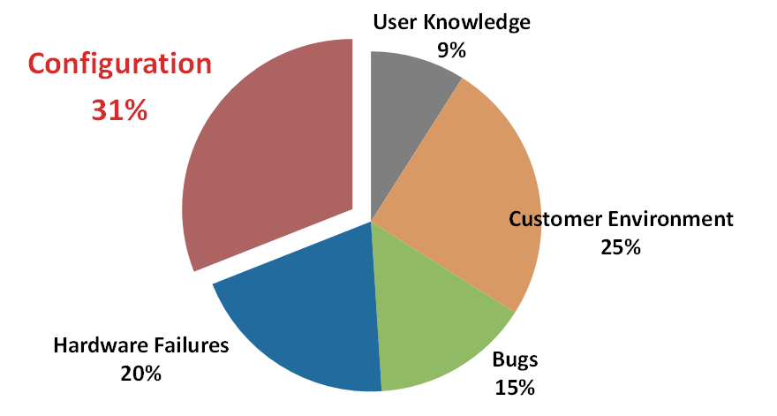
Sysadmin errors go beyond security
Root causes for “high-severity” customer cases [our SOSP’11]

Slide 9
Sysadmin Misconfiguration in Google
Root causes for service level disruption in one of Google’s main services (From Book by Google "The Data Center as a Computer” chapter 7, page 82 http://www.morganclaypool.com/doi/pdf/10.2200/s00193ed1v01y200905cac006)
*Data Source: “The Datacenter as a Computer”

Slide 10
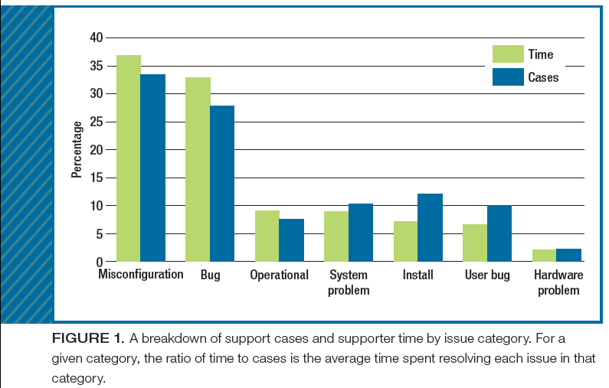
Configuration errors in Hadoop
Hadoop
Root causes of support tickets
[Rabkin et al, IEEE Computer’13]
Notes:
Nevertheless, configuration errors are prevalent.
I know many of you have seen this pie chat for several times. Let me present it for the 2nd last time.
This pie chart shows the root causes of high-severity customer issues of Storage-A, a commercial storage system from a major storage company in US (actually our collaborators).
Similar statistics are observed and reported in many other types of systems, such as Hadoop systems.
This one is from Cloudera. We can see that the dominant cause of Hadoop cluster failures are misconfigurations.

Slide 11

Configuration errors are in a Grey Zone
Who should be blamed?
Developers? Sysadmins? Or Both?
11
Notes:
One thing we want to emphasize is that misconfigurations are usually in a grey zone,
Developers may think it is users’ problems that they don’t configure the system in a correct way, but the users may think it is developers’ problem that that they design the system’s configuration to be complex and error-prone.
This may partly explain why no one had comprehensively studied misconfigurations .

Slide 12
Software Bugs vs. Configuration Errors
 | Software Bugs | Configuration Errors
Symptoms/ impacts | Crash, hang, incorrect results, security attachs … | Can also cause crash, hang, security holes.
Issue tracking | Well documented, many tools (e.g. bugzilla) | Much less rigorously tracked
Diagnosis | debugging | Similar process
After diagnosis | Developers fix the bug, testing and release patches | Developers relieved Often no action taken afterwards
Can user fix it? | Mostly no | YES and easily (if the right error msg is given to users)
We take a much less active role in handling and preventing sysadmin’s configuration errors

Slide 13
Our Project and Current Status
Understanding real world misconfigurations
Real world misconfiguration study [SOSP’11]
Real world security-related misconfiguration[CHI’17]
Address it in a more fundamental way
Handle misconfigurations gracefully [SOSP’13] (With Netapp)
Detecting environmental related misconfigurations [ASPLOS’14] (with IBM)
Cloud infrastructure configuration management (EuroSys’15) (with Microsoft Azure)
Configuration complexity (FSE’15)
Latent configuration detection (OSDI’16 best paper) (with NetApp)
Acheck: Detecting and Monitoring Impact of Access-control Configuration Changes (under review)

Slide 14
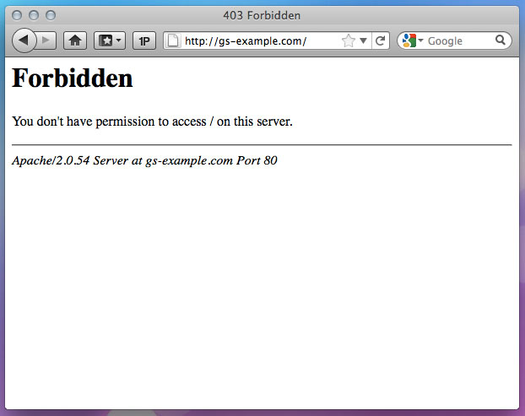

Access-denied issues
2
Notes:
All the stories I’m going to talk about start from notorious messages of “access denied”.
I think all of you encountered such messages before, right?
I believe that you saw this not because you were accessing illegal content you’re not supposed to access.
In fact, many times the access denials are unintended, undesired; and are causing problems not only to you,
but also to service providers. because if the pages or services cannot be accessed, they are losing money.

Slide 15


Access-denied issues
SYSADMIN
2

Slide 16

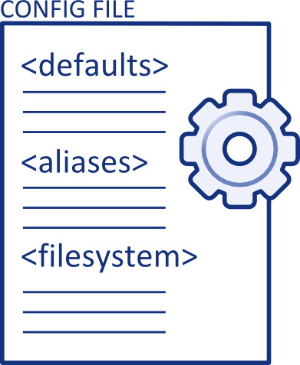
Access-denied issues
SYSADMIN
not developers
do not debug code
do not read code
Many have only 1-2 year training
not end users
care about security of the entire system
2
2
Notes:
typically, these access-denied issues go to system administrators who are responsible for managing the system infrastructure that provide high-level services such as websites.
They are the target users of our study;
Sysadmins are a very special user group,
they are not the developers who implement the software, and
For example, the sysadmins who manage the websites are not one who implement web servers such as Apache and Ngnix.
they seldom read code; if they are managing commercial systems, they don’t even have the access to the source code.
For similar reason, they don’t, and often can’t, debug the code.
Instead, they mostly solve problems by modifying configurations of the software.
On the other hand, sysadmins are not end users either.
System administration, by definition is technical inclined;
they have to address issues reported by end users;
also, they do care about security as one primary aspect of system administration.
So how do sysadmins deal with access-denied issues?

Slide 17
Access-denied issues
SYSADMIN
How do sysadmins resolve these issues?
not developers - do not debug code - do not read code
not end users - technical inclined - care about security
2

Slide 18


A real world example -- Symptom
GET hello.html
403
2
Notes:
back to our example, which is a real-world example.
We all know that the web pages are served by web servers, in this example, Apache web server, which is essentially a piece of software running on top of the OS, in this example, Linux.
Basically, what happens here is Apache receives the user’s HTTP GET request and returns a 403 error code.

Slide 19

A real world example -- Diagnosis
GET hello.html
403
2
Notes:
So the key to resolving this issue is to understand why apache deny the access.
The common practices for sysadmins to develop the understanding is to check Apache’s error logs.
The content is like this.

Slide 20
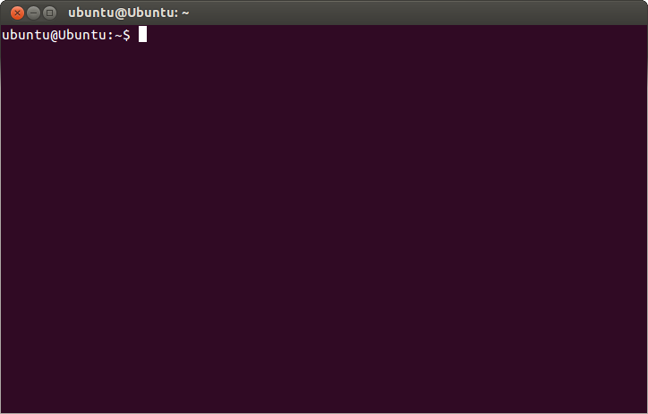
A real world example -- Diagnosis
GET hello.html
403
> tail /etc/httpd/logs/error_log
[Fri Mar 08 16:31:17.001047 2013] [lbmethod_heartbeat:notice] [pid 16874:tid 139980380780288] AH02282: No slotmem from mod_heartmonitor
[Fri Mar 08 16:31:17.001601 2013] [core:warn] [pid 16874:tid 139980380780288] AH00098: pid file /home/tianyin/httpd-2.4.3/logs/httpd.pid overwritten -- Unclean shutdown of previous Apache run?
[Fri Mar 08 16:31:29.623715 2013] [core:error] [pid 16874:tid 139980097713920] [authz_core][client:132.239.17.127:38873] client denied by server configuration: /www/var/gs-example/hello.html
[Fri Mar 08 16:31:30.436072 2013] [core:error] [pid 16874:tid 139980089321216] [authz_core][client:132.239.17.127:38873] client denied by server configuration: /www/var/gs-example/hello.html
[Fri Mar 08 16:31:53.384598 2013] [unique_id:info] [pid 16940:tid 140544777680640] AH01566: using ip addr 127.0.1.1[Fri Mar 08 16:31:54.007416 2013] [auth_digest:notice] [pid 16940:tid 140544777680640] AH01757: generating secret for digest authentication ...
[Fri Mar 08 16:31:54.008406 2013] [unique_id:info] [pid 16940:tid 140544777680640] AH01566: using ip addr 127.0.1.1
[Fri Mar 08 16:31:55.001190 2013] [lbmethod_heartbeat:notice] [pid 16940:tid 140544777680640] AH02282: No slotmem from mod_heartmonitor
2
4
Notes:
In our study, most sysadmins are able to identify the specific log entries corresponding a given access-deny event from the entire log file, and in this example, this is the only log entry.

Slide 21

[authz_core][client:132.239.17.127] Client denied by server configuration: /www/var/gs/hello.html
useless
“Allow from all” in httpd.conf
Add “132.239.17.127” in “/etc/hosts”
Restart httpd under a different OS user
Make “/www/var/gs” world readable
useless
useless
useless
“Require ip 132.239.17.127” in httpd.conf
3
Notes:
It says the client from a specific ip is denied by server configurations when accessing the URL.
So the sysadmin’s job is to grant the access to this specific client.
Let’s look at the problem-solving process of this sysadmin.
First, the sysadmins added “allow from all” in Apache’s configuration file, with the intention of allowing all the IP address.
However, this didn’t work.
Then, he started to suspect the denials was caused by OS-level configuration. So He first added the client ip in /etc/hosts, didn’t work either. Then restart the web server process under another OS user, no luck.
The last attempt he made is to relax the file permissions to make the file path world executable.
Unfortunately, the access was still denied.

Slide 22
[authz_core][client:132.239.17.127] Client denied by server configuration: /www/var/gs/hello.html
useless
“Allow from all” in httpd.conf
Add “132.239.17.127” in “/etc/hosts”
Restart httpd under a different OS user
Make “/www/var/gs” world-readable
useless
Risky! Insecure!
useless
useless
“Require ip 132.239.17.127” in httpd.conf
3
5
Notes:
As many of you have already noticed, the last attempt creates security holes: it opens up the execute permission to everybody.
We refer to such configuration that grant access to those who are not supposed to have such access as security misconfigurations.

Slide 23



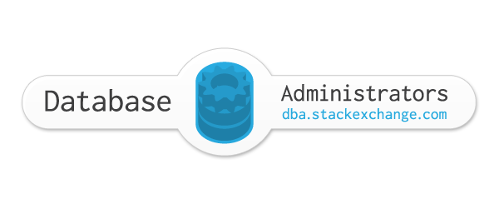




Our Study
486 real-world access-denied issues
of four large system software projects
Apache web server
MySQL
Hadoop
CentOS
from mailing lists and sysadmin forums
(only for Hadoop)
7
Notes:
Let me first explain the methodology. In fact, studying security related configuration is pretty challenging, because nobody is willing to share their configurations with others, and lab study is hard to resemble real-world practices.
We collect more than 400 real-world access-denied issues of four systems software projects,
Apache web server
MySQL database server
Hadoop big data analytics framework
And CentOS, a linux distribution for Enterprise use
We collect our dataset from the mailing list of the studied systems software and sysadmin-oriented web forums.
We select cases when sysadmins failed to resolve access-denied issues and thus asked for help.
In this case, they are willing to share those sensitive information, such as their configurations and systems environment;
and explain their attempts in details.

Slide 24
Our Study
486 real-world access-denied issues
of four system software projects
from mailing lists and sysadmin forums
Analyze the problem resolution process
root-causes
systems error messages
Fixing attempts
suggestions by others
7
7
Notes:
For each case selected, we focus on analyzing the sysadmins’ problem-solving process in the field.
Specially, we record the following information,
the root cause configuration that denied the access
systems feedback like log and console messages,
configuration attempts made by sysadmins, including useless attempts and security misconfigurations
and configuration suggested by others as potential solutions

Slide 25
Contributions
An empirical study on how sysadmins handle real world access deny cases
What are common insecure fixes?
How are they introduced in the field?
Obstacles to fix access permission correctly
What information/tools are missing?
Implications and opportunities
How can we (software developers and SE researchers) help?
6
6
Notes:
Our paper makes the following contributions,
First, we propose a new perspective of studying misconfigurations in the context of access control.
We present an in-depth analysis of the common security misconfigurations and the way they are introduced in the field.
This naturally helps understand the obstacles faced by sysadmins that present correct access-control configurations, specially, what information and tools are missing.
Last but not the least, we present the implications of the results, and opportunities for software developers to change the current situation.

Slide 26
Main Results
Risky, insecure fixes occurred in 38.1% of the studied access-denied issues.
70.3% of access-denied issues took sysadmins multiple useless and event risky trial-and-error process
49.7% of fixing attempts were useless in resolving the access-denied issues.
4
Notes:
This example is not a corner case, but a VERY representative one.
We observe that security misconfigurations are prevalent---they were introduced in 38.1% of the access-denied issues in our study.
Just like this example, most security misconfigurations were associated with useless configuration attempts irrelevant to the root cause of the problems, which indicates that the sysadmins do not crisply know the root cause, but try things in a trial-and-error approach.
In fact, around 50% of security misconfigurations were useless---they can’t solve the problem and cause security holes.

Slide 27
Common insecure fixes to access-denied issues
disable protection
Grant all priv.
add permission.
Example: SELINUX=disabled
8
Notes:
We categorize security misconfigurations into
“disable protection of the security module” like disable SELINUX,
“over-grant unnecessary privileges of subjects,” such as granting all the privileges of all the tables to a regular users in MySQL, which clearly creates security problems,
and “downgrade permission of objects.” such as opening up file permissions to be world executable, as we have seen in the previous example

Slide 28
Common security misconfigurations
disable protection
Grant all priv.
add permission.
Example:
GRANT ALL *.* TO Alice
8

Slide 29
Common security misconfigurations
disable protection
Grant all priv.
add permission.
Example:
chmod a+x secret
8

Slide 30
Common security misconfigurations
disable protection
over-grant priv.
add permission.
Apache
60.0%
31.7%
MySQL
53.3%
44.4%
Hadoop
81.1%
13.5%
CentOS
84.2%
12.2%
8
Notes:
We observe that “disabling protection” is the most common type of security misconfigurations across all the software systems studied.
This is likely because disabling the entire module is considered as a quick way to bypass access control checks, compared with setting access-control configurations.
As we will see later, real-world sysadmins face tremendous difficulties in even understanding configurations.
As I mentioned early, around half of these security misconfigurations failed to work around the access-denied issues,
including those that disabled the entire security modules.
Therefore, relaxing access control in a trial and error fashion without precise understanding
is not an effective way to resolve these issues.

Slide 31
Common security misconfigurations
disable protection
over-grant priv.
downgrade perm.
49.7% of these insecure fixes don’t even fix the reported access-denied issues.
Apache
60.0%
31.7%
MySQL
53.3%
44.4%
Hadoop
81.1%
13.5%
CentOS
84.2%
12.2%
8

Slide 32
Resolution through trial and error
Didn’t realize access control was the root cause
Blind restore
wrong problem
wrong module
wrong parameter
wrong setting
9
Notes:
To understand why many configuration attempts through trial and error are useless.
We classify useless configuration attempts into five categories,
Blind restore means the sysadmins blindly restart the system or reinstall the software;
Wrong problem means the sysadmins didn’t realize access control as the root causes but are modifying other configurations.
Wrong module, wrong parameter, and wrong settings explain why the attempted configuration is useless.

Slide 33
Distributions of useless fixes
Didn’t realize access control was the root cause
Ad-hoc restore
wrong problem
wrong module
wrong parameter
wrong setting
Apache
44.9%
31.9%
MySQL
20.7%
48.3%
Hadoop
41.0%
35.9%
CentOS
40.9%
23.7%
Most dominant
9
Notes:
We observe that wrong modules and wrong parameters are the two dominating reasons---

Slide 34
Distribution of useless fixes
Blind restore
wrong problem
wrong module
wrong parameter
wrong setting
Most sysadmins know access control causing problems, but cannot nail down the precise modules and parameters.
Apache
44.9%
31.9%
MySQL
20.7%
48.3%
Hadoop
41.0%
35.9%
CentOS
40.9%
23.7%
9
Notes:
This show that most of the time sysadmins know access control causing the issues but cannot nail down the precise modules and parameters.

Slide 35
Security misconfigurations are frequently suggested on web forums & mailing lists
Security misconfigurations were suggested in 14.8% of the studied access-denied issues.
Voting-based moderation is ineffective in suppressing insecure suggestions.
ServerFault (22.4% )
StackOverflow (16.7%)
48.6% of the suggested insecure fixes were blindly tried!
10
11
Notes:
One contributing factor to the prevalence of security misconfigurations is that they are frequently suggested on web forums and mailing list as potential solutions.
We observe that some security misconfigurations have very high votes on ServerFault and StackOverflow as they are able to workaround the issues,
despite the vulnerabilities they cause.
simple voting based moderation, adopted by ServerFault and StackOverflow is ineffective in suppressing these insecure suggestions. Some security misconfigurations are actually ranked pretty high, because they do work around the access-denied issues despite causing vulnerabilities.
Moreover, 48.6% of the suggested misconfigurations were actually adopted by sysadmins who were desperate to allow the denied access.

Slide 36

Obstacles to correct configurations
Log messages fail to help sysadmins develop the precise understanding of the root cause.
Security requires precise settings.
[authz_core][client:132.239.17.127] Client denied by server configuration: /www/var/gs/hello.html
“Apache’s error logs simply say I don’t have permission to access the file, [and] isn’t telling me anything more useful, and my searches [via the Internet] have all told to ensure the permissions are set correctly.”
11
12
Notes:
The fundamental obstacle that prevents correct configurations is the lack of precise information that can help sysadmins develop the precise understanding of the root cause of the denied access such as the missing permissions.
Note that the information has to be precise, because security means precise settings that follow the principle of the least privilege.
Without precise information, how can sysadmins fix the issues with precise settings?
If you still remember the log message in the example I explained in the beginning of the talk.
It really sucks… right?? Basically it tells nothing but “some”…
As commented by the sysamdins,

Slide 37
Deficiency of existing log messages
Study the log messages in 6 software projects (Apache, MySQL, Lighttpd, VSFTPD, Hadoop, HBase)
1. identify program locations that deny access
2. inspect usability of access-denied messages
Study the log messages in 6 software projects (Apache, MySQL, Lighttpd, VSFTPD, Hadoop, HBase)
1. identify program locations that deny access
2. inspect ”usability” of access-denied log msgs
Two major usability problems
not precise (not pinpointing root causes)
not informative (missing critical details)
12
13
Notes:
To systematically understand the deficiency of existing log messages, we study the log messages in six systems software projects;
We first identify the program locations where access gets denied, typically, these locations have clear patterns such as return an error code.
Then, we inspect the usability of the log messages when the access is denied.
TODO:
The two major usability problems revealed by our study is that

Slide 38
Example: too general notifications
/* httpd-2.4.20*/
status ip_check_authz(request_rec *r, ...) {
... ← return AUTHZ_GRANTED if r’s IP is allowed
return AUTHZ_DENIED;
}
status host_check_authz(request_rec* r, ...) {...}
status method_check_authz(request_rec* r, ...) {...}
...
if (auth_status == AUTHZ_DENIED) {
ap_log_rerror(APLOG_MARK, APLOG_ERR, 0, r, APLOGNO(01631)
“user %s authorization failure for %s.”, r->user, r->uri);
}
13
Notes:
Let me just give show you a tiny example from Apache web server.
I was actually told a million times that don’t put code in the slides for a HCI conference, but I still want to do it…
Apache basically provides ip-based access control. It is implemented by this check function.
If the ip of the request, r, is allowed, it returns a AUTHZ_GRANTED; otherwise it returns AUTHZ_DENIED.
Note that this check function does not print any log.
In apache, there are a number of different check functions like this, such as
Host-based and method based access control.
And all these checks, if denying the request, end up with exactly the same log message.
So as a sysadmins, there’s no way to understand, based on this log message, what exactly denied an access request.

Slide 39
Example: too general notifications
/* httpd-2.4.20*/
status ip_check_authz(request_rec *r, ...) {
...
return AUTHZ_DENIED;
}
status host_check_authz(request_rec* r, ...) {...}
status method_check_authz(request_rec* r, ...) {...}
...
Only 66.5% of the program locations that deny access have specific messages.
Only 41.2% of the messages contain root-cause configurations.
if (auth_status == AUTHZ_DENIED) {
ap_log_rerror(APLOG_MARK, APLOG_ERR, 0, r, APLOGNO(01631)
“user %s: authorization failure for %s.”, r->user, r->uri);
}
13
Notes:
In general, we find only….

Slide 40
Obstacles to correct configurations
“Apache’s error logs simply say I don’t have perm- ission to access the file, [and] isn’t telling me anything more useful, and my searches have all told to ensure the permissions are set correctly.”
Log messages are the main feedback
87.0% of sysadmins check logs
91.3% of them find corresponding log entries
only 1.6% of sysadmins looked at source code
no sysadmins tried to debug code
11
Notes:
The main obstacle that prevents correct configuration solutions is the lack of precise feedback information, as indicated by many of the comments of sysadmins.
Here is a representative one.
“””
“””
Note that log messages are the main feedback channel for sysadmins to understand and resolve access-denied issues.
Among all the studied cases, most sysadmins check logs but few of them try to understand the code even all the studied software is open sourced.

Slide 41
Pattern 2: Missing critical information
} else if (APR_STATUS_IS_EACCESS(rv)) {
ap_log_rerror(APLOG_MARK, APLOG_ERR, rv, r
“access to %s denied.”
r->uri);
return r-status = HTTP_FORBIDDEN;
}
14

Slide 42
Pattern 2: Missing critical information
+ [v2.4.1]
+ [v2.4.1]
} else if (APR_STATUS_IS_EACCESS(rv)) {
ap_log_rerror(APLOG_MARK, APLOG_ERR, rv, r
“access to %s denied ”,
“because search permissions are missing ”
“on a component of a path.”,
r->uri);
return r-status = HTTP_FORBIDDEN;
}
14

Slide 43
Implications and Future Work
Opportunities for tooling support
auto-discover missing permissions
auto-fix access-denied issues
Acheck: Detecting and Monitoring Impact of Access-control Configuration Changes [under review]
Log enhancement for better diagnosibility of security issues [ongoing]
14
Notes:
I’d like to conclude by summarizing the implications of our results.
I think whenever we want to present useful information, we need understand the purpose of the information---who is going to use this information? How will they consume this information.
In this context, access-control related logs are very different from other log messages with different purposes such as failure diagnosis or interactive debugging.
Therefore, they have special usability principles.
In general, these log messages should enable sysadmins to fix access-denied issues with precise access-control configurations.
Right now, this is missing in real-world widely-used systems software.
Also, I personally believe that though security configuration, exemplified by access-control configurations, are terribly complicated for human admins to make correct, they can, and should be, automated.

Slide 44
Conclusions
To err is human (人是会犯错的）
Risky, insecure fixes are commonly introduced as workarounds of access-denied issues.
More future work are needed
Humans are becoming expensive
Automation and more intelligent tools to help?
AI ☺
15
Notes:
With this, I leave the conclusion here and I’d like to take questions.
Thank you!
To conclude, today I show you how security misconfigs are commonly introduced to work around access-denied issues in the real world, and how ineffective they are.
To prevent security misconfigurations, software engineering practices and tool support are desired to enable precise fix, which is our ongoing work.
The dataset is available online, so feel free to download and take a look.

